Slide 1
Capstone Project - Exploring and Clustering Restaurants in Pune, India

Slide 2
Introduction
Pune is a large city with an area of 331 sq.km. Pune is also home to an eclectic crowd of food-lovers and the city serves up everything from Western favourites to Asian delicacies
In this project I will explore and group the restaurants in the city of Pune in few categories based on the Ratings and Price range of the Restaurants
The target audience for such a project is of two types. This project will help the food-loving people of Pune to shortlist and plan their visit to the restaurants accordingly.
This project will also help businesses who are looking to invest in eateries in the Pune city.

Slide 3
Data Acquisition & data cleaning
Based on definition of our problem, factors that will influence our decision are: 1. The location of the Restaurants in Pune 2. The categories of these restaurants 3. The Ratings of these restaurants 4. The Price range of these restaurants
The data source that I will use to fetch the location information, the categories, ratings and price range of restaurants will be the FourSquare API
The data of restaurants obtained from Foursquare API corresponding to the Rating and Price range, had many records where the Price range was not specified .Those records were removed
The data of restaurants obtained from the Foursquare API had several entries or records , where the column had ‘NaN’ values.The rows containing ‘NaN’ values were removed

Slide 4
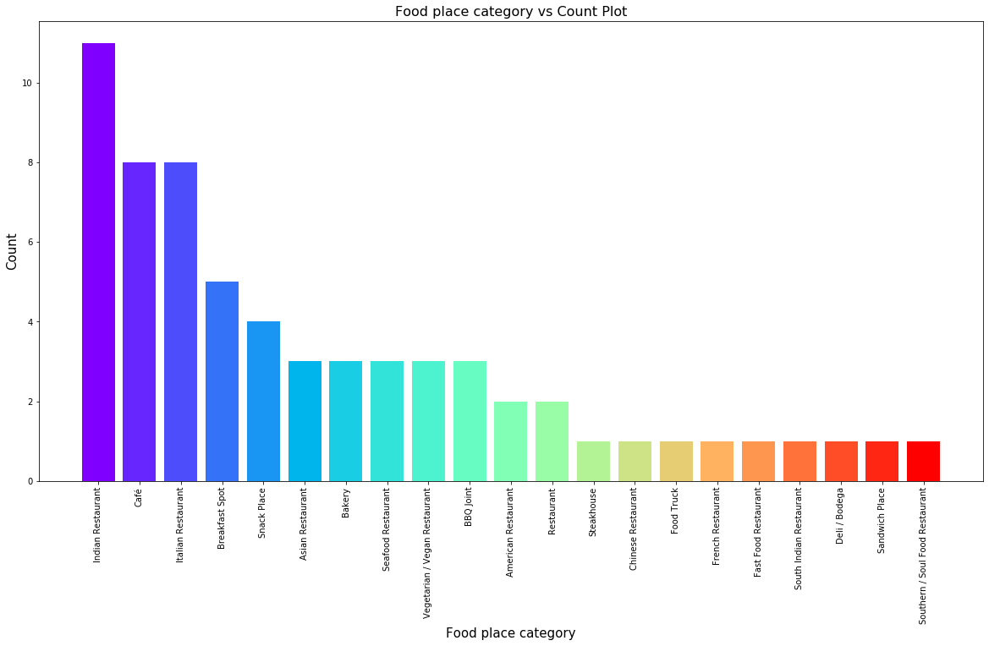
Methodology and Exploratory Data Analysis
Plot of Category Distribution
From this plot we understood that the 3 most popular categories of Eateries in Pune are Indian Restaurants, Cafe and Italian Restaurants

Slide 5
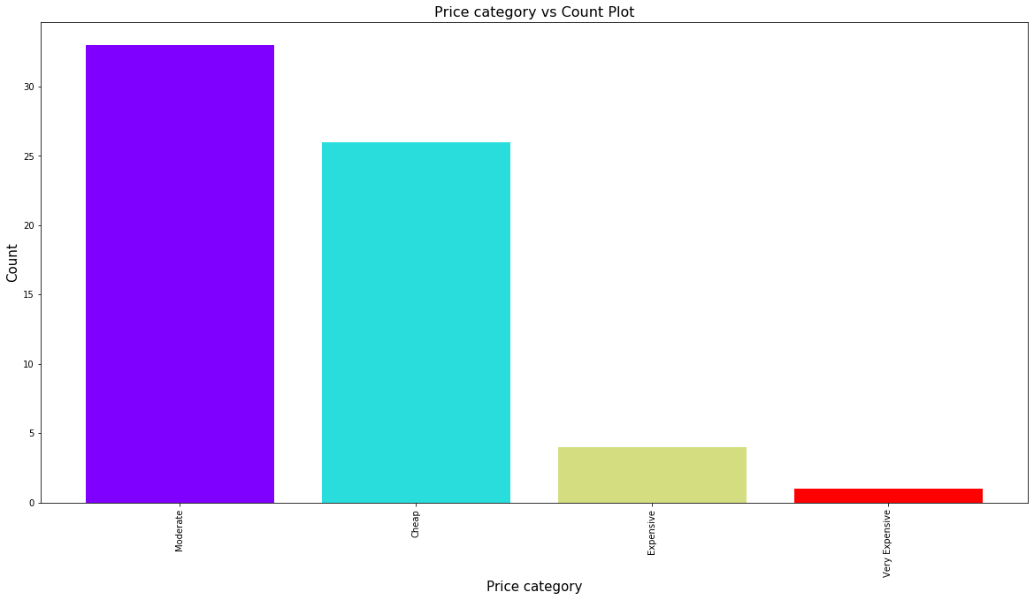
Methodology and Exploratory Data Analysis
Price Category Plot
From this plot we understood that the majority restaurants in Pune are Moderately priced or Cheaply priced. There are very few Expensive/Very Expensive restaurants in Pune

Slide 6
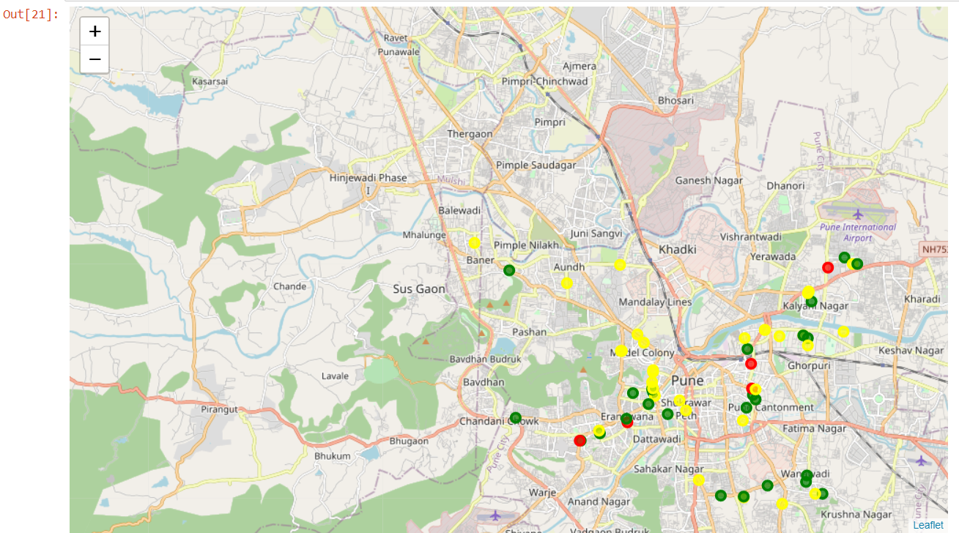
Modeling
Clustering Model was used which produced 3 clusters. The Map obtained after Clustering the data into three categories :
The Green points in the map indicate Cheaply priced restaurants, Yellow points in the map indicate Moderately priced restaurants and Red indicate Expensive Restaurants

Slide 7
Conclusion
The purpose of this project was to explore and group the restaurants in Pune based on their Ratings and Price range in order to help people locate the restaurants according to their needs.In this project we collected the required data, proccessed it, analyzed it and performed clustering of these restaurants and identified the places where we can find the restaurants of desired categories
We found that Cheaply priced Restaurants are located mainly in the Wanawadi area and the Pune Cantonment area, while the Moderately priced Restaurants mainly are located near Deccan Gymkhana and Bund Garden road and the Expensive/Very Expensive Restaurants are located mainly near Kothrud and Pune Junction area

Slide 8
Thank you

